Slide 1
Render to textures
Advanced Graphics Programming

Slide 2
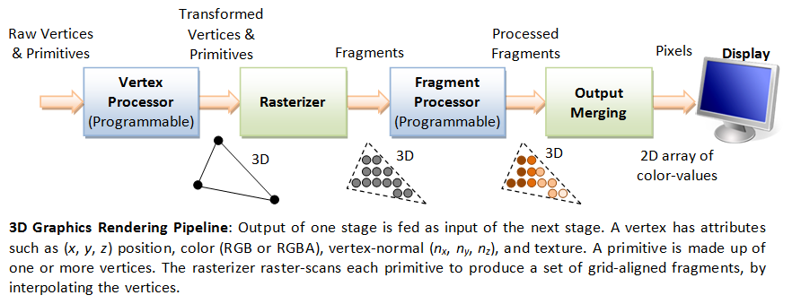
Graphics rendering pipeline

Slide 3
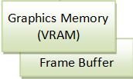
The frame buffer
Frame Buffer: Special part of the graphics memory.
The display reads colors from the Frame Buffer.
Raster scan
Refresh rate 60Hz

Slide 4
The frame buffer
Writing pixel values to the Frame Buffer
Last stage in the rendering pipeline
Results are presented on the display
No way to deal with those colors anymore

Slide 5
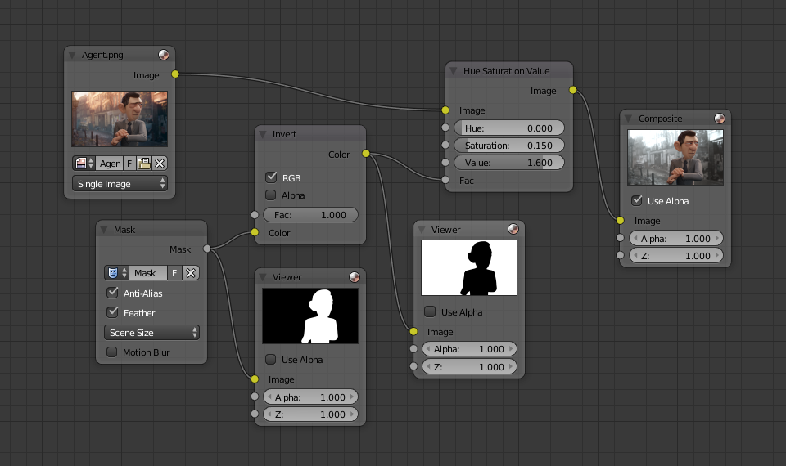
But we want to work with those pixels...

Slide 6
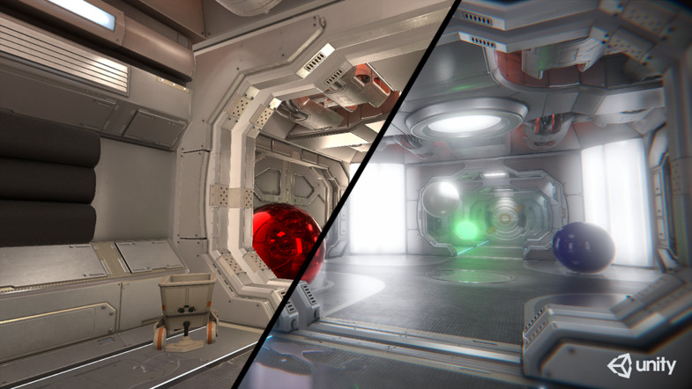
But we want to work with those pixels...

Slide 7
Render target
From Wikipedia:
In the field of 3D computer graphics, a render target is a feature of modern graphics processing units (GPUs) that allows a 3D scene to be rendered to an intermediate memory buffer, or Render Target Texture (RTT), instead of the frame buffer or back buffer. This RTT can then be manipulated by pixel shaders in order to apply additional effects to the final image before displaying it.
So, a render target is a texture or set of textures where we render geometry.
And Framebuffer Objects in OpenGL allow implementing render targets.

Slide 8
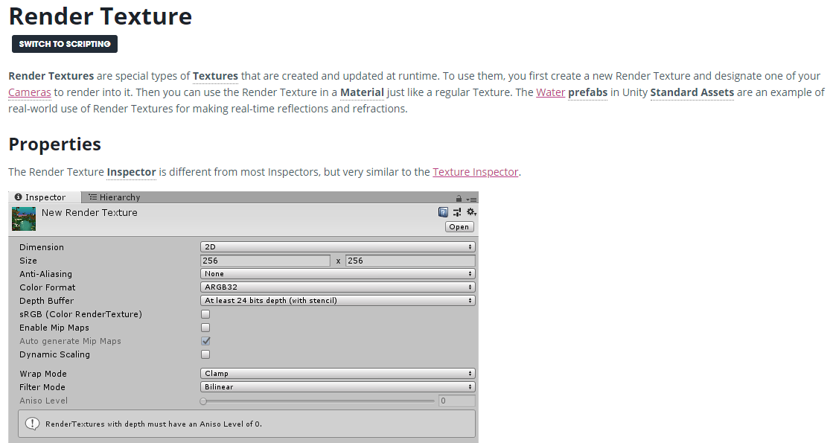
Render targets in Unity (Render Textures)

Slide 9
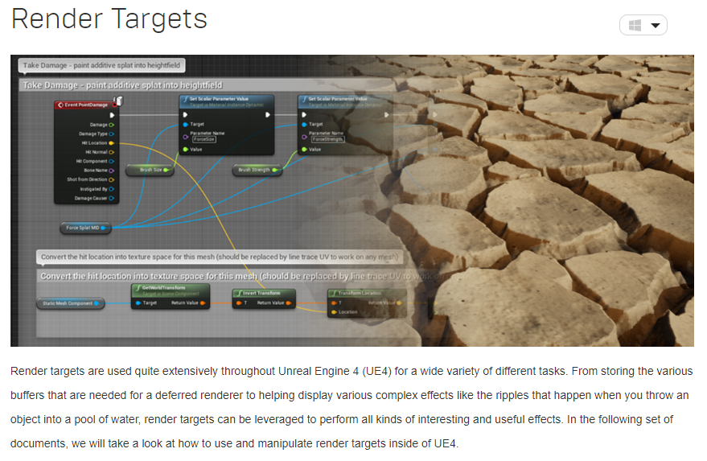
Render targets in Unreal Engine 4

Slide 10

Render targets in OpenGL
So… how do we implement render targets (or render to texture) in OpenGL?

Slide 11
Framebuffer Objects
Framebuffer Object 1
We can write to Framebuffer Objects instead of writing to the default Frame Buffer
Pixels will be still available in the graphics memory.
Framebuffer Object 2
...
Framebuffer Object N

Slide 12
The default Frame Buffer
Typical configuration...
Frame Buffer
Front color buffer
swap buffers
Back color buffer
pixels
Depth buffer
Stencil buffer

Slide 13
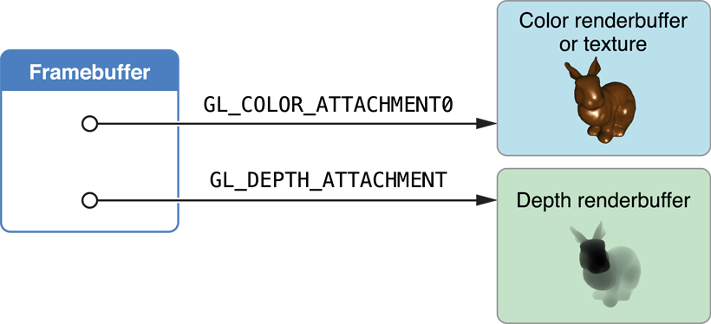
Framebuffer Objects
Framebuffer Object 1
We can have a Framebuffer Object and attach one or multiple textures to several of its attachment points (including color, depth, and stencil).
Color attachment 0
Texture A
pixels
Color attachment 1
...
Color attachment N
Depth attachment
Texture B
Stencil attachment

Slide 14
Framebuffer Objects
Transformed Vertices & Primitives
Raw Vertices & Primitives
Processed Fragments
Fragments
Pixels
Vertex Processor
(Programmable)
Rasterizer
Fragment Processor
(Programmable)
Output Merging
Framebuffer Object 1
Color attachment 0
Color attachment 1
...
Color attachment N
Texture A
Depth attachment
Stencil attachment
Texture B

Slide 15
Sample code: Creation of textures and framebuffer object
gl->glGenTextures(1, &colorTexture);
gl->glBindTexture(GL_TEXTURE_2D, colorTexture);
gl->glTexParameteri(GL_TEXTURE_2D, GL_TEXTURE_MIN_FILTER, GL_NEAREST);
gl->glTexParameteri(GL_TEXTURE_2D, GL_TEXTURE_MAG_FILTER, GL_NEAREST);
gl->glTexParameteri(GL_TEXTURE_2D, GL_TEXTURE_WRAP_R, GL_CLAMP_TO_EDGE);
gl->glTexParameteri(GL_TEXTURE_2D, GL_TEXTURE_WRAP_S, GL_CLAMP_TO_EDGE);
gl->glTexImage2D(GL_TEXTURE_2D, 0, GL_RGBA8, width, height, 0, GL_RGBA, GL_UNSIGNED_BYTE, nullptr);
gl->glGenTextures(1, &depthTexture);
gl->glBindTexture(GL_TEXTURE_2D, depthTexture);
gl->glTexParameteri(GL_TEXTURE_2D, GL_TEXTURE_MIN_FILTER, GL_NEAREST);
gl->glTexParameteri(GL_TEXTURE_2D, GL_TEXTURE_MAG_FILTER, GL_NEAREST);
gl->glTexParameteri(GL_TEXTURE_2D, GL_TEXTURE_WRAP_R, GL_CLAMP_TO_EDGE);
gl->glTexParameteri(GL_TEXTURE_2D, GL_TEXTURE_WRAP_S, GL_CLAMP_TO_EDGE);
gl->glTexImage2D(GL_TEXTURE_2D, 0, GL_DEPTH_COMPONENT24, width, height, 0, GL_DEPTH_COMPONENT, GL_FLOAT, nullptr);
gl->glGenFramebuffers(1, &fbo);
gl->glBindFramebuffer(GL_FRAMEBUFFER, fbo);
gl->glFramebufferTexture2D(GL_FRAMEBUFFER, GL_COLOR_ATTACHMENT0, GL_TEXTURE_2D, colorTexture, 0);
gl->glFramebufferTexture2D(GL_FRAMEBUFFER, GL_DEPTH_ATTACHMENT, GL_TEXTURE_2D, depthTexture, 0);
gl->glDrawBuffer(GL_COLOR_ATTACHMENT0);
Done during initialization or when regenerating textures (e.g. during a window resize).

Slide 16
Sample code: Checking the status of a framebuffer object
GLenum status = gl->glCheckFramebufferStatus(GL_FRAMEBUFFER);
switch(status)
{
case GL_FRAMEBUFFER_COMPLETE: // Everything's OK
break;
case GL_FRAMEBUFFER_INCOMPLETE_ATTACHMENT:
qDebug() << "Framebuffer ERROR: GL_FRAMEBUFFER_INCOMPLETE_ATTACHMENT"; break;
case GL_FRAMEBUFFER_INCOMPLETE_MISSING_ATTACHMENT:
qDebug() << "Framebuffer ERROR: GL_FRAMEBUFFER_INCOMPLETE_MISSING_ATTACHMENT"; break;
case GL_FRAMEBUFFER_INCOMPLETE_DRAW_BUFFER:
qDebug() << "Framebuffer ERROR: GL_FRAMEBUFFER_INCOMPLETE_DRAW_BUFFER"; break;
case GL_FRAMEBUFFER_INCOMPLETE_READ_BUFFER:
qDebug() << "Framebuffer ERROR: GL_FRAMEBUFFER_INCOMPLETE_READ_BUFFER"; break;
case GL_FRAMEBUFFER_UNSUPPORTED:
qDebug() << "Framebuffer ERROR: GL_FRAMEBUFFER_UNSUPPORTED"; break;
default:
qDebug() << "Framebuffer ERROR: Unknown ERROR";
}
Make sure to check the status of the framebuffer object after configuring it.

Slide 17
Sample code: Usage of a framebuffer object
// Select our framebuffer object for rendering
gl->glBindFramebuffer(GL_FRAMEBUFFER, fbo);
// Clear color (if needed)
gl->glClearDepth(1.0);
gl->glClearColor(0.4f, 0.4f, 0.5f, 1.0f);
gl->glClear(GL_COLOR_BUFFER_BIT | GL_DEPTH_BUFFER_BIT);
// Geometry passes (configure OpenGL state, shaders, and draw geometry)
passMeshes(camera);
passGrid(camera);
// Select the default frame buffer again
QOpenGLFramebufferObject::bindDefault();
Done at each frame when we want to render the scene into the color and depth textures.

Slide 18
Sample code: Usage of a framebuffer object
// Select our framebuffer object for rendering
gl->glBindFramebuffer(GL_FRAMEBUFFER, fbo);
// Clear color (if needed)
gl->glClearDepth(1.0);
gl->glClearColor(0.4f, 0.4f, 0.5f, 1.0f);
gl->glClear(GL_COLOR_BUFFER_BIT | GL_DEPTH_BUFFER_BIT);
// Geometry passes (configure OpenGL state, shaders, and draw geometry)
passMeshes(camera);
passGrid(camera);
// Select the default frame buffer again
QOpenGLFramebufferObject::bindDefault();
Done at each frame when we want to render the scene into the color and depth textures.
To render geometry we will have to use shaders. More precisely, fragment shaders will need to have an output that matches the FBO configuration.

Slide 19
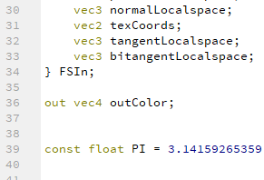
Sample code: Fragment shader must match
// Creation and configuration of textures
// …
// Creation and configuration of a framebuffer object
gl->glGenFramebuffers(1, &fbo);
gl->glBindFramebuffer(GL_FRAMEBUFFER, fbo);
gl->glFramebufferTexture2D(GL_FRAMEBUFFER, GL_COLOR_ATTACHMENT0, GL_TEXTURE_2D, colorTexture, 0);
gl->glFramebufferTexture2D(GL_FRAMEBUFFER, GL_DEPTH_ATTACHMENT, GL_TEXTURE_2D, depthTexture, 0);
gl->glDrawBuffer(GL_COLOR_ATTACHMENT0);

Slide 20
Sample code: Fragment shader must match
// Creation and configuration of textures
// …
// Creation and configuration of a framebuffer object
gl->glGenFramebuffers(1, &fbo);
gl->glBindFramebuffer(GL_FRAMEBUFFER, fbo);
gl->glFramebufferTexture2D(GL_FRAMEBUFFER, GL_COLOR_ATTACHMENT0, GL_TEXTURE_2D, colorTexture1, 0);
gl->glFramebufferTexture2D(GL_FRAMEBUFFER, GL_COLOR_ATTACHMENT1, GL_TEXTURE_2D, colorTexture2, 0);
gl->glFramebufferTexture2D(GL_FRAMEBUFFER, GL_DEPTH_ATTACHMENT, GL_TEXTURE_2D, depthTexture, 0);
gl->glDrawBuffer(GL_COLOR_ATTACHMENT0);
This fragment shader has only one output
Here we choose to only draw to a single color attachment
We can have several color attachments

Slide 21
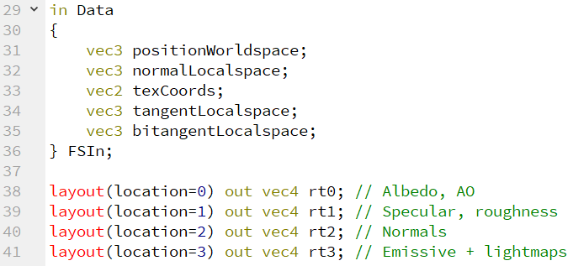
Sample code: Fragment shader must match
// Creation and configuration of textures
// …
// Creation and configuration of a framebuffer object
gl->glGenFramebuffers(1, &fbo);
gl->glBindFramebuffer(GL_FRAMEBUFFER, fbo);
gl->glFramebufferTexture2D(GL_FRAMEBUFFER, GL_COLOR_ATTACHMENT0, GL_TEXTURE_2D, colorTexture1, 0);
gl->glFramebufferTexture2D(GL_FRAMEBUFFER, GL_COLOR_ATTACHMENT1, GL_TEXTURE_2D, colorTexture2, 0);
gl->glFramebufferTexture2D(GL_FRAMEBUFFER, GL_COLOR_ATTACHMENT1, GL_TEXTURE_2D, colorTexture3, 0);
gl->glFramebufferTexture2D(GL_FRAMEBUFFER, GL_COLOR_ATTACHMENT1, GL_TEXTURE_2D, colorTexture4, 0);
gl->glFramebufferTexture2D(GL_FRAMEBUFFER, GL_DEPTH_ATTACHMENT, GL_TEXTURE_2D, depthTexture, 0);
GLenum buffers[] = { GL_COLOR_ATTACHMENT0, GL_COLOR_ATTACHMENT1,
GL_COLOR_ATTACHMENT2, GL_COLOR_ATTACHMENT3 };
gl->glDrawBuffers(4, buffers);
We can have several color attachments
Here we choose to draw to several color attachments
This fragment shader has several outputs

Slide 22
Sample code: Using the rendered texture
Done at each frame if we want to use the texture where the FBO has rendered geometry.
if (program.bind())
{
program.setUniformValue("colorTexture", 0);
gl->glActiveTexture(GL_TEXTURE0);
gl->glBindTexture(GL_TEXTURE_2D, colorTexture);
resourceManager->quad->submeshes[0]->draw();
}

Slide 23
Usage models
Keep one FBO with N textures attached to it
Change render targets with glDrawBuffers
Keep one FBO and change its attachments dynamically
Change render targets by attaching different textures
Keep several FBOs with textures attached
Change render targets by binding FBOs

Slide 24
Usage models
Keep one FBO with N textures attached to it
Change render targets with glDrawBuffers
Keep one FBO and change its attachments dynamically
Change render targets by attaching different textures
Keep several FBOs with textures attached
Change render targets by binding FBOs
Framebuffer Object 1
Color attachment 0
Texture A
Color attachment 1
Texture B
...
Color attachment N
GLenum buffs[] =
{ GL_COLOR_ATTACHMENT0 };
gl->glDrawBuffers(1, buffs);
Depth attachment
Stencil attachment

Slide 25
Usage models
Keep one FBO with N textures attached to it
Change render targets with glDrawBuffers
Keep one FBO and change its attachments dynamically
Change render targets by attaching different textures
Keep several FBOs with textures attached
Change render targets by binding FBOs
Framebuffer Object 1
Color attachment 0
Texture A
Color attachment 1
Texture B
...
Color attachment N
GLenum buffs[] =
{ GL_COLOR_ATTACHMENT1 };
gl->glDrawBuffers(1, buffs);
Depth attachment
Stencil attachment

Slide 26
Usage models
Keep one FBO with N textures attached to it
Change render targets with glDrawBuffers
Keep one FBO and change its attachments dynamically
Change render targets by attaching different textures
Keep several FBOs with textures attached
Change render targets by binding FBOs
Framebuffer Object 1
Color attachment 0
Texture A
Color attachment 1
Texture B
...
Color attachment N
GLenum buffs[] =
{ GL_COLOR_ATTACHMENT0,
GL_COLOR_ATTACHMENT1 };
gl->glDrawBuffers(2, buffs);
Depth attachment
Stencil attachment

Slide 27
Usage models
Keep one FBO with N textures attached to it
Change render targets with glDrawBuffers
Keep one FBO and change its attachments dynamically
Change render targets by attaching different textures
Keep several FBOs with textures attached
Change render targets by binding FBOs
Framebuffer Object 1
Color attachment 0
Texture A
Color attachment 1
...
Color attachment N
Depth attachment
Stencil attachment

Slide 28
Usage models
Keep one FBO with N textures attached to it
Change render targets with glDrawBuffers
Keep one FBO and change its attachments dynamically
Change render targets by attaching different textures
Keep several FBOs with textures attached
Change render targets by binding FBOs
Framebuffer Object 1
Color attachment 0
Texture B
Color attachment 1
...
Reconfiguring the attachments of a Framebuffer Object is more expensive than having several attachments and switching among them with glDrawBuffers()...
Color attachment N
Depth attachment
Stencil attachment

Slide 29
Usage models
Keep one FBO with N textures attached to it
Change render targets with glDrawBuffers
Keep one FBO and change its attachments dynamically
Change render targets by attaching different textures
Keep several FBOs with textures attached
Change render targets by binding FBOs
Framebuffer Object 1
Color attachment 0
Texture A
Color attachment 1
...
Color attachment N
Depth attachment
Stencil attachment

Slide 30
Usage models
Keep one FBO with N textures attached to it
Change render targets with glDrawBuffers
Keep one FBO and change its attachments dynamically
Change render targets by attaching different textures
Keep several FBOs with textures attached
Change render targets by binding FBOs
Framebuffer Object 2
Color attachment 0
Texture B
Color attachment 1
...
Changing among several configured FBOs is probably not so expensive as reconfiguring a single FBO several times (driver consistency checks), but indeed more expensive than changing render targets with glDrawBuffers.
Color attachment N
Depth attachment
Stencil attachment

Slide 31
Usage models
Prefer changing render targets in the same FBO with glDrawBuffers than resetting FBO attachments or binding different FBOs.
Whenever possible.
Anyway… probably not the bottleneck of your application.

Slide 32
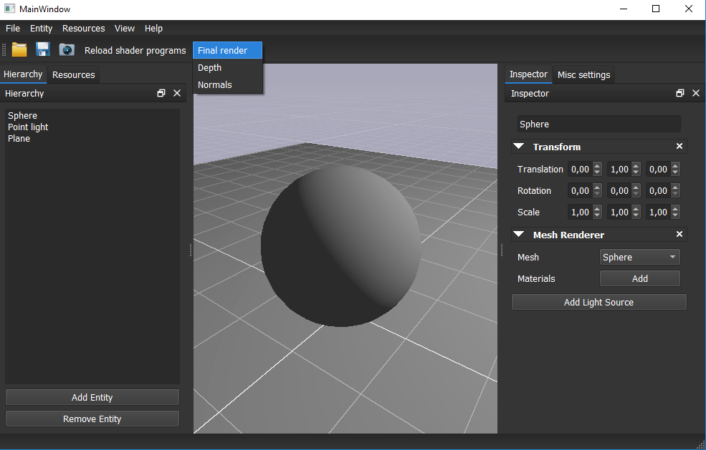
Exercise
Modify your graphics engine so that:
In a first pass render your scene into a texture using a framebuffer object.
In a second pass, render a screen-filling quad to blit the texture with the rendered scene onto screen.
When we have several intermediate render targets, we will be able to select which one to visualize on the scene viewer.
For instance:
Final render
Normals
Ambient occlusion
Albedo
...

Slide 33
Questions?

